Slide 1

Hotel Booking Demand
Created by Qiqi Yu and Yi Shi (Team 25).

Slide 2



CONTENT
01
02
03
Data Set
Questions
Data app demo

Slide 3

0 1
Data Set

Slide 4
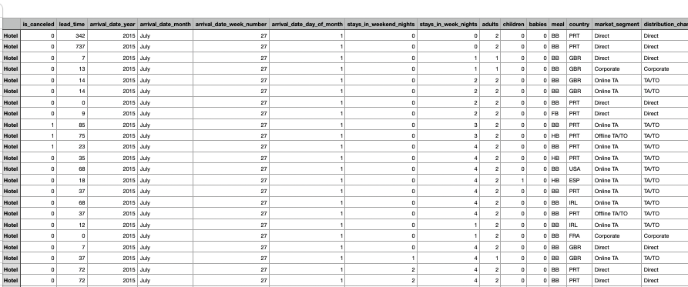
Data set (Hotel Booking Demand)

Slide 5
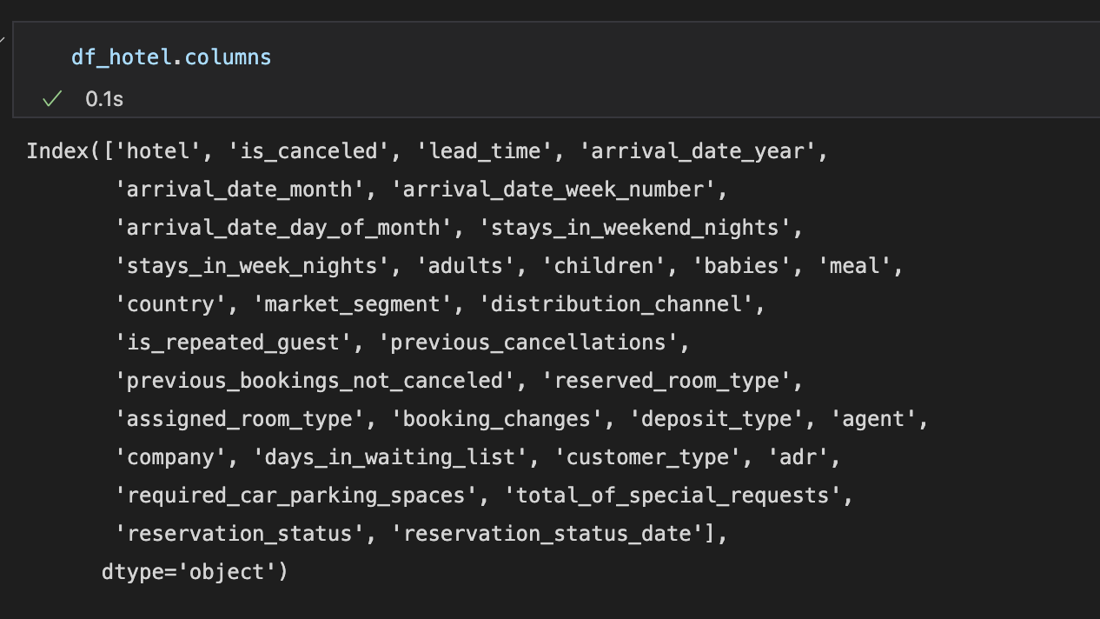
Columns

Slide 6
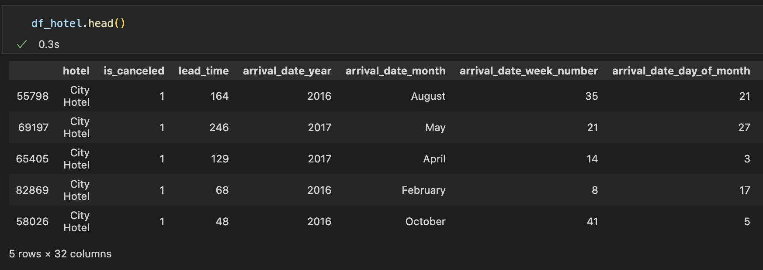
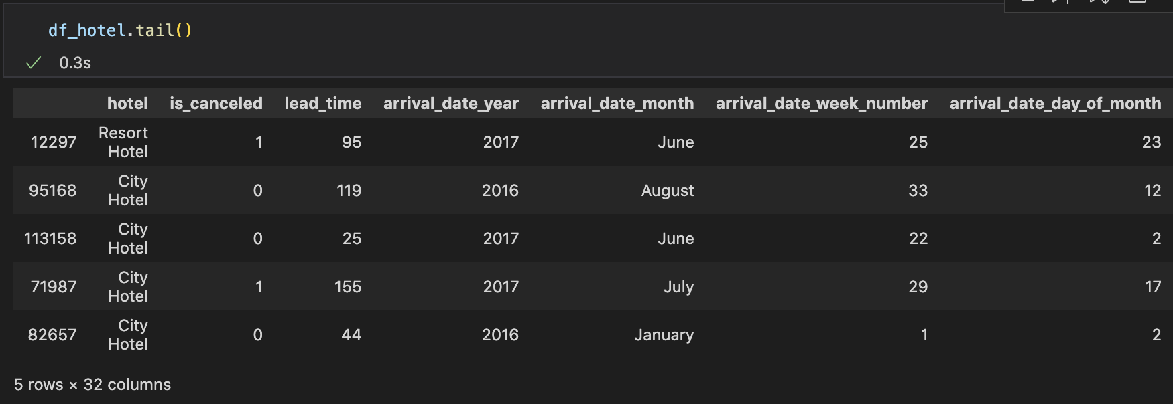
data
The first and last five rows of the data set

Slide 7
0 2
Analysis

Slide 8
Questions
Q1
Comparison of arrivals at two hotels
Q2
The impact of weekdays and weekends on the number of bookings and cancellations
Q3
The impact of the arrival number on the price

Slide 9
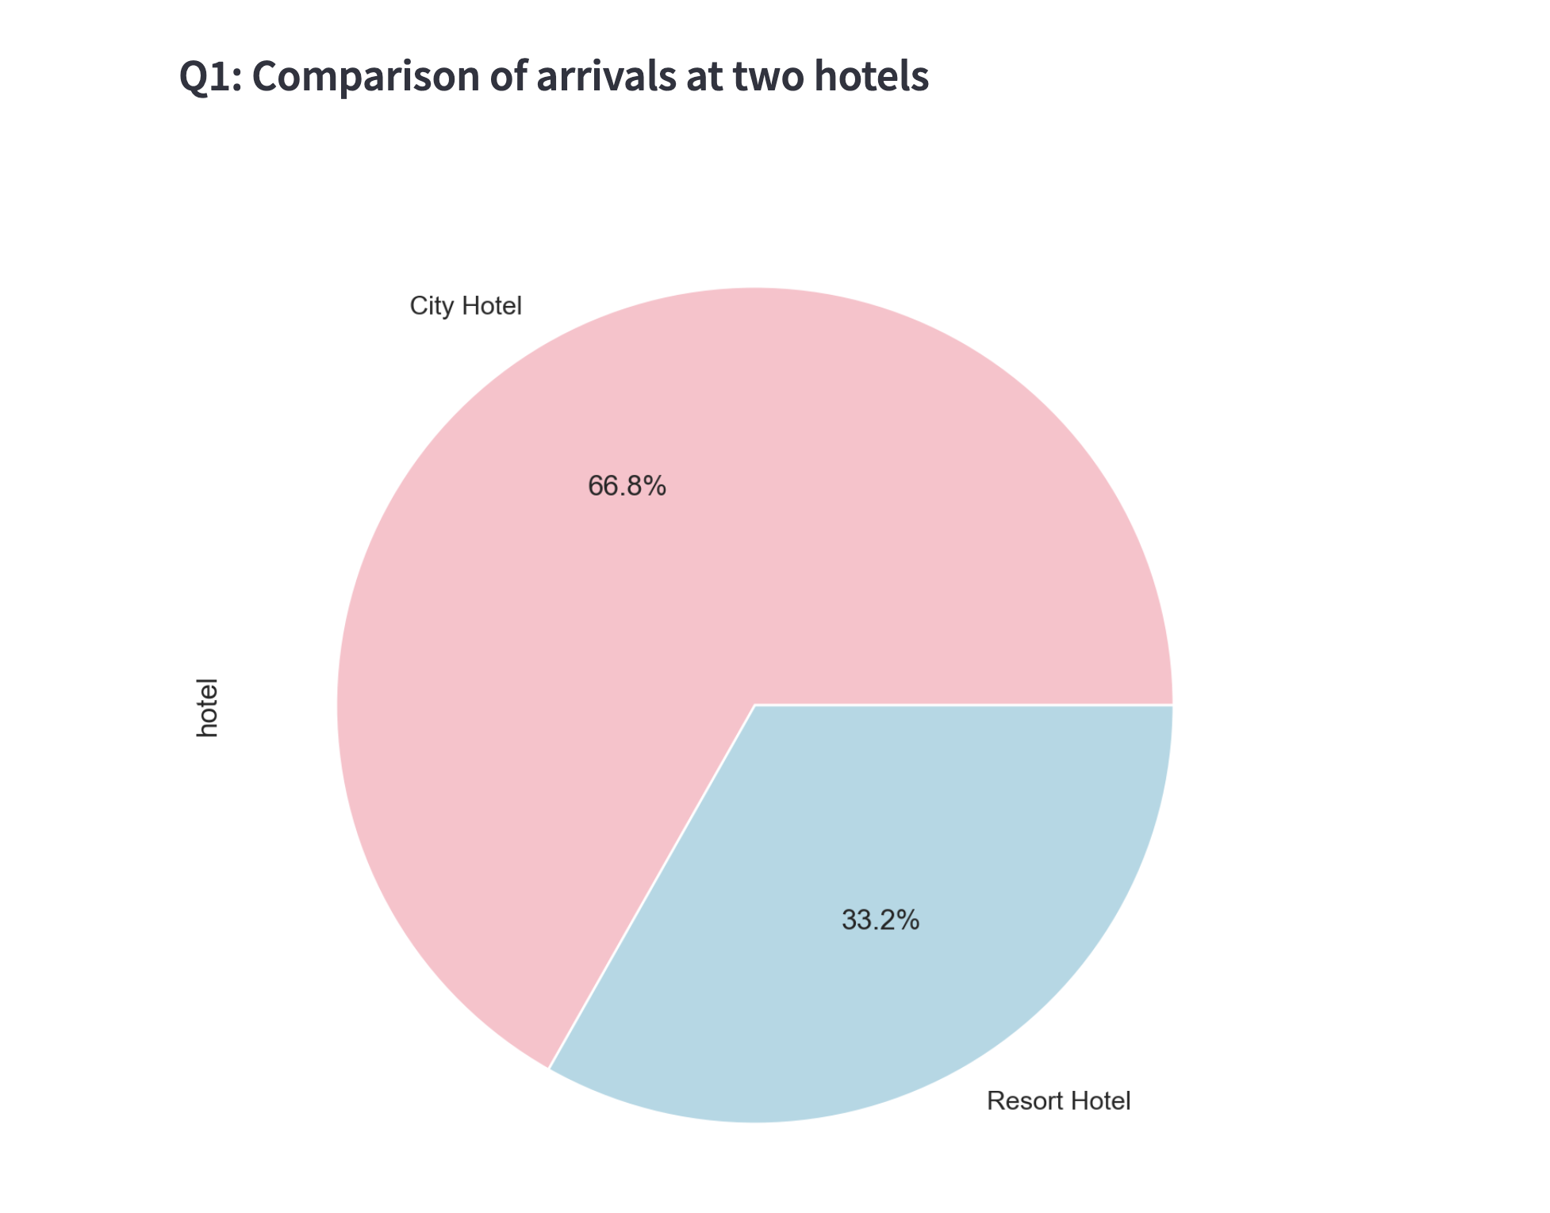
City hotel has significantly more arrivals than resort hotel.

Slide 10
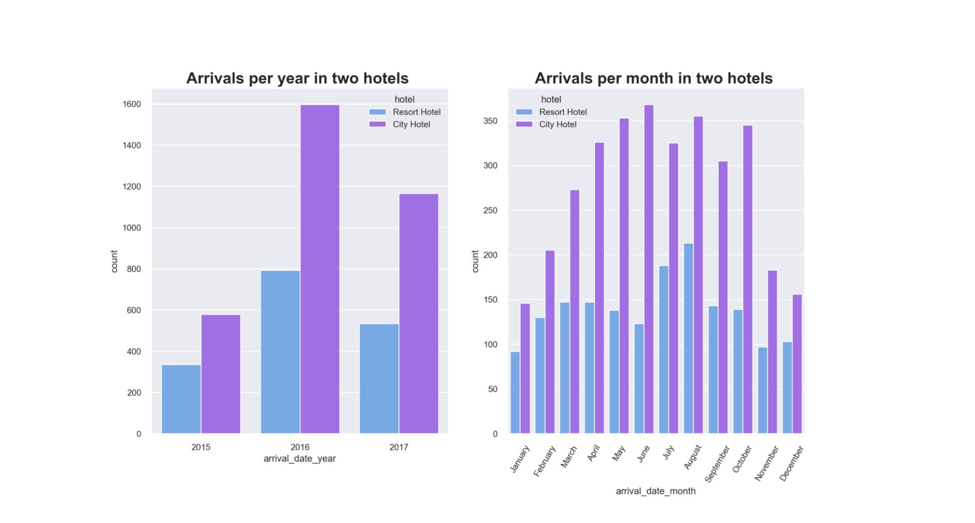
Both arrivals per year and arrivals per month in city hotel are more than those in resort hotel.
In every dimension of time, city hotel are more popular.

Slide 11
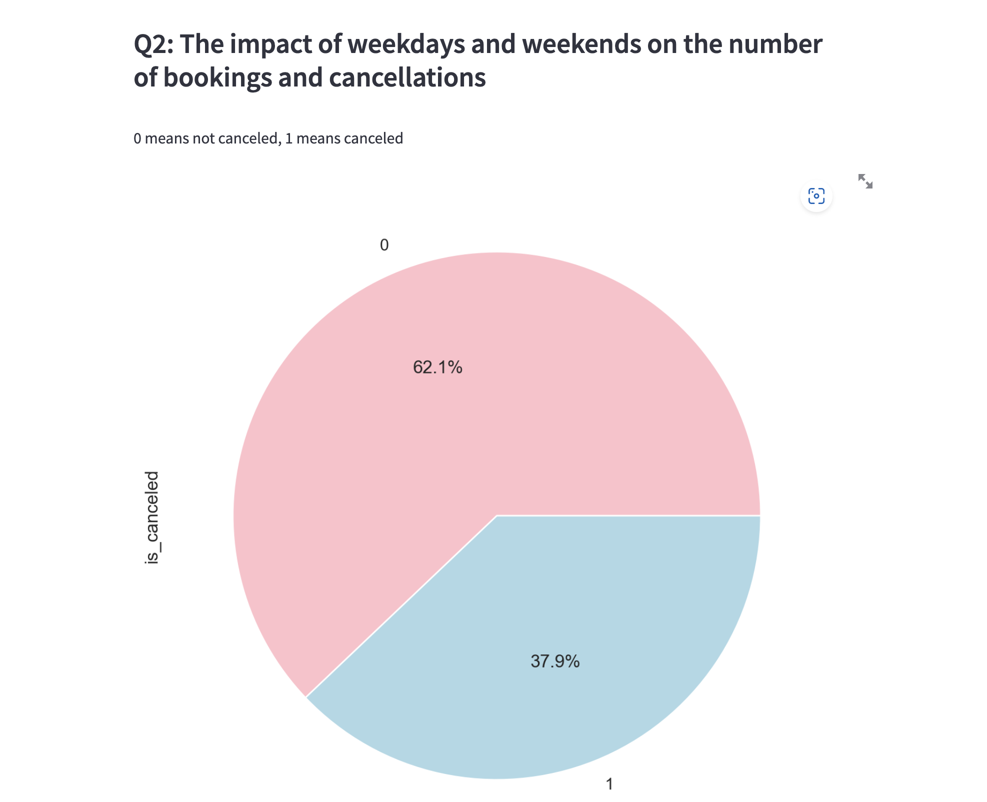
The number of people who have not cancelled is more than the number who have cancelled.

Slide 12
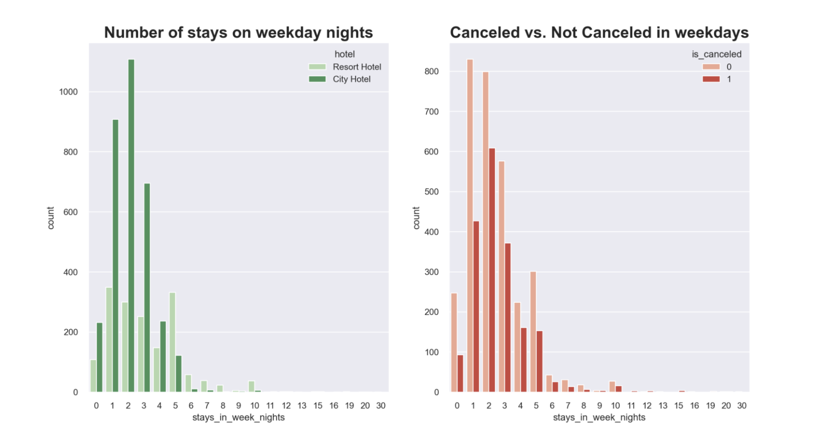
Weekday night stays were more in city hotel.
Most of weekday nights which are booked are not canceled.

Slide 13
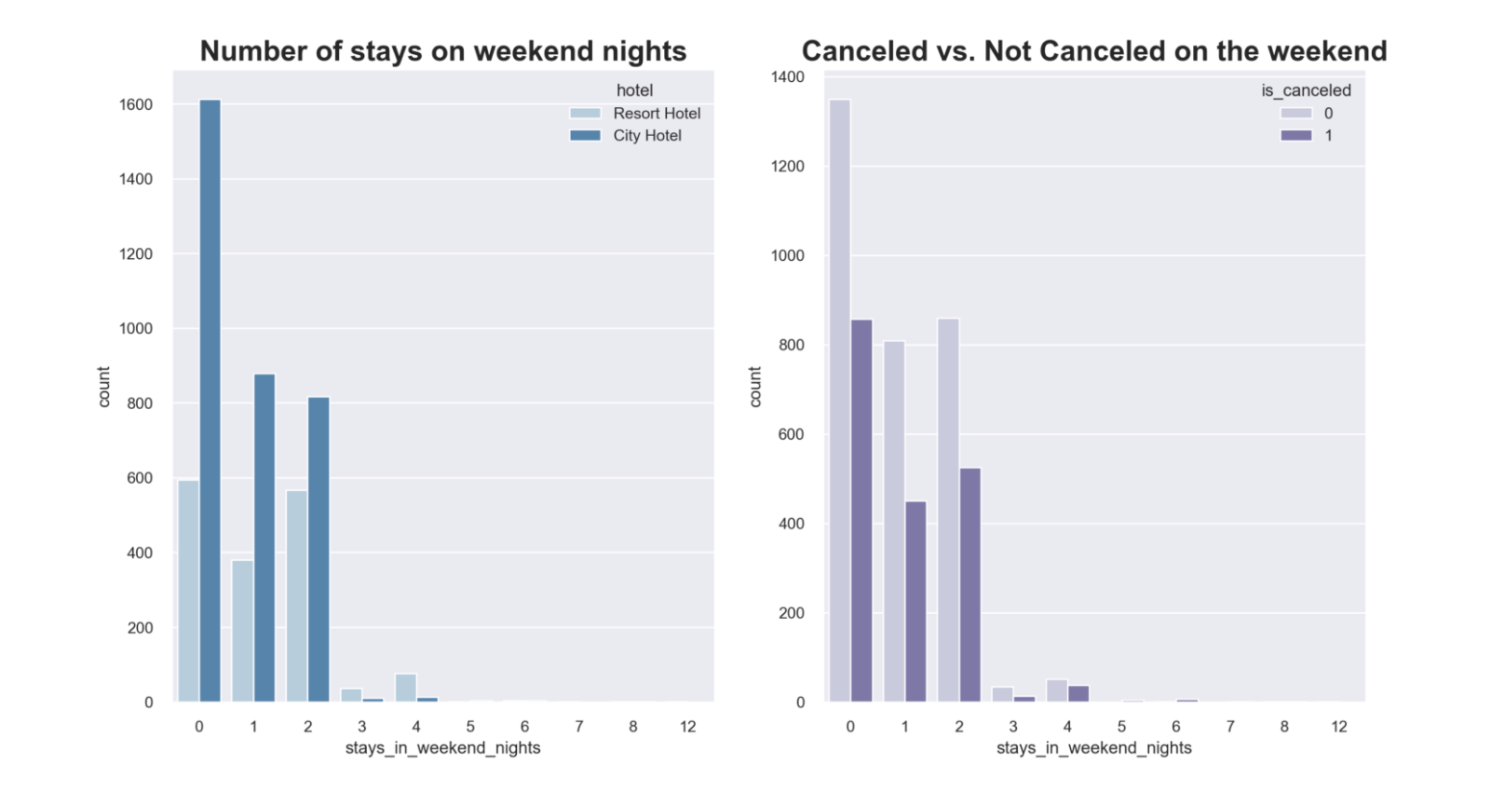
Most of the weekend nights are booked in city hotel.
Most of weekend nights which are booked are not canceled.
Weekends or weekdays do not affect the number of stays or cancellation rates.

Slide 14
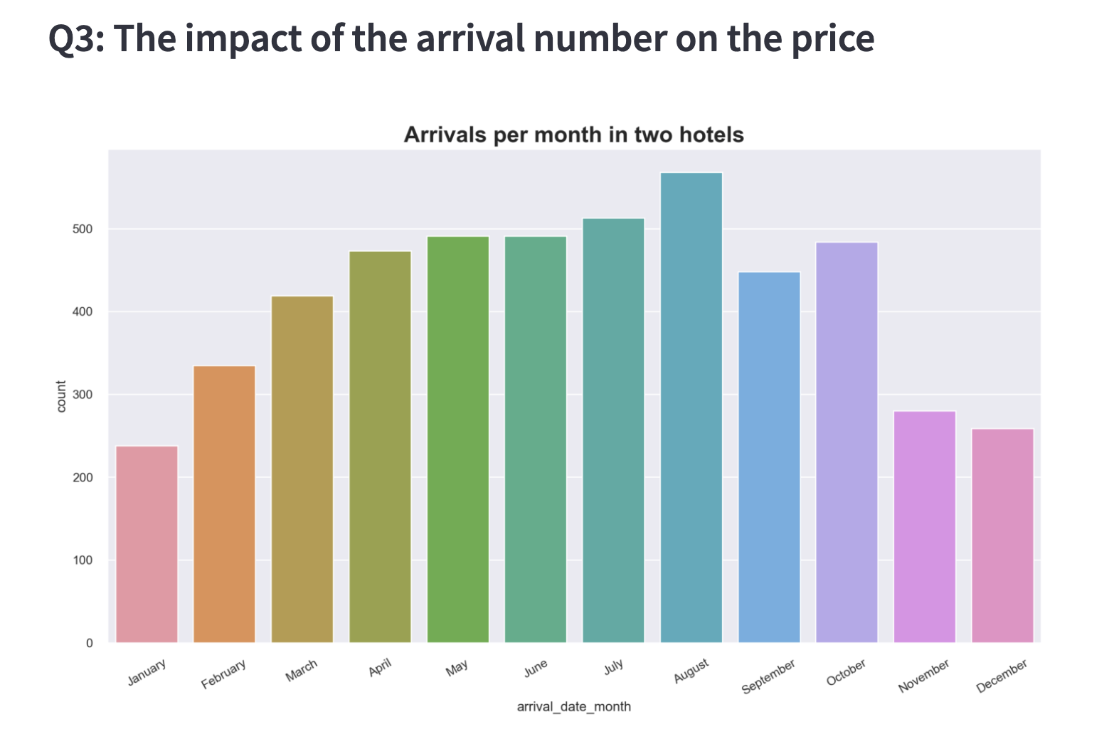
Here price is represented by average daily rate.
Average daily rate =
sum of all loading transactions /
total number of staying nights
The change trend of the number of arrivals per month in two hotels is first increasing and then decreasing, reaching the maximum in August.

Slide 15
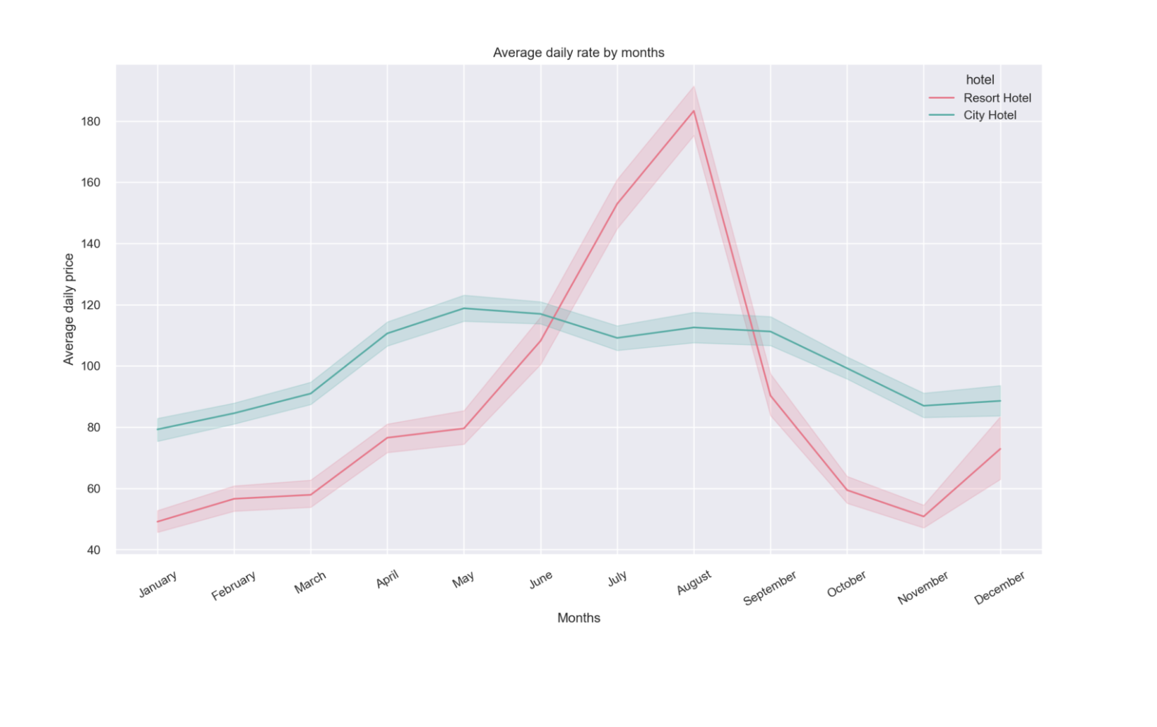
The change trend of the average daily rate of resort hotel is basically consistent with the number of arrivals per month, while the change of average daily rate of city hotel is not obvious.
So at least for resort hotels, the higher the number of arrivals, the higher the price.
Our group speculate that the reason for such a result is that more people choose to go to resort hotel for the summer in August.
Therefore, the owner of resort hotel should pay more attention to the marketing in summer to attract more customers and provide them with better service.

Slide 16
0 3
Data app demo
daisy77777-final-app-final-y579me.streamlit.app

Slide 17
THANK YOU

